Slide 1
The Bottleneck Effect: Using Value Stream Maps to Improve Delivery Flow
Matt Ring
Nick Herrig
Agile/Technical Coach
@mjring
IT Operations

Slide 2


The Lean Movement
Toyota’s “Failure” in the US Market
1957: Toyopet was 1st Toyota car to sell in America
It was terrible, unreliable. “Couldn’t keep pace with other cars.”
Toyota’s productivity was 1/8th the world standard
1962: Toyota’s productivity was equal the world standard
1965: Toyota re-entered US market w/ new line of cars
Compact cars were more affordable & reliable than competitors
1968: Toyota’s productivity was twice the world standard
Notes:
History of lean manufacturing at Toyota:
I always thought Toyota was always great!, Steven Spears –DevOps Enterprise Summit
Address poor quality, slow speed of car delivery
James McGraw wasn’t impressed, commenting: “This thing is underpowered, overpriced and it won’t sell.”
Use of Kanban, Andon cord, small batch size, implement quality checks (focused on bottleneck)

Slide 3
The Lean Movement
The Toyota Production System
Aggressively seek out problems in what they’re doing
Reduce excess inventory
Improve throughput
Implement quality checks throughput the system
See, Solve, Spread
Notes:
Three Goals of TPM:
Reduce excess inventory (partially done work)
Improve throughput
Reduce operational expense

Slide 4
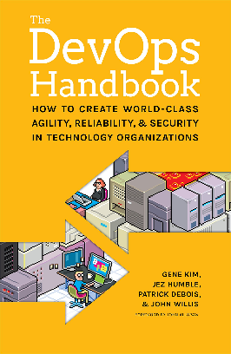
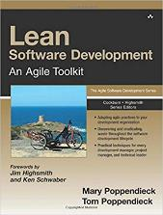
Lean Software Delivery
Concepts that carry over
Make work visible
Limit work in progress
Reduce batch sizes
Reduce the number of handoffs
Identify and elevate our constraints
Eliminate waste in the value stream
Notes:
Make Work Visible: This is a lot easier in manufacturing, the tech value stream is invisible. Sprint planning board
Limit WIP: Customer orders dictact work, but tech work is much more dynamic. Limite multi tasking and setting WIP limit
Reduce handoffs: Siloed teams networking, storage, load balancers, ISR
Eliminate Waste in the Value Stream: next slide...

Slide 5
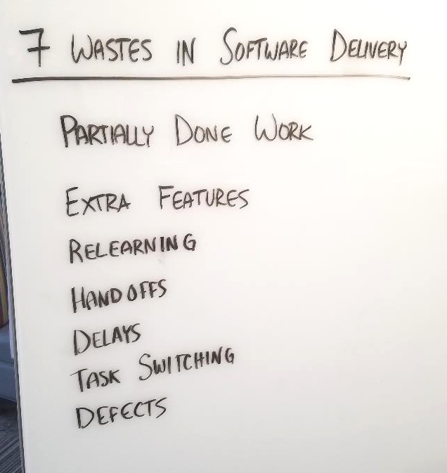
Notes:
Mary & Tom Poppendieck wrote a great book that maps lean manufacturing concepts do the IT and software development space. Within that book, they also show what waste within software delivery looks like.
Partially done work – Incomplete, WIP
Extra Features – overproduction, gold-plating, features not used, not providing value
Relearning – Time spent re-discovering a solution (in code, technical requirements, etc.
Handoffs – between different teams collaborating on similar work
Delays – from queueing systems and emails
Task Switching – between WIP
Defects – Low complete and accurate work
Transition:
So what does this actually look like in our organizations?
https://codepunk.io/the-seven-wastes-of-software-development/

Slide 6
Story Time…

Slide 7
It started on a Monday…
Notes:
Well, this already sounds ominous… “It’s about to go down…”

Slide 8
I’ve got an idea!
Monday Night (Day 0)
Notes:
Meet Devin. D
Developer on a software delivery team, came up with a new idea that he thinks will improve the customer experience at the company. He thinks that, by adding a piece of new functionality, that will increase product conversion rates.

Slide 9
I could have it deployed this afternoon.
Sounds great!
What if…?
Devin
Stacy (PO)
Devin
8:45am
9:00-11:00am
Tuesday (Day 1)
Notes:
8:45am: Daily standup. Devin presents idea. PO Stacy says, “let’s do it.” We’ve got capacity.
9 – 11am: Devin hammers out the new feature on a feature branch. Team using trunk-based development.

Slide 10

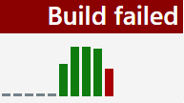
So… hungry…
It worked on my machine!
PR submitted. Where’s Phil?
What?
Devin
Phil (Tech Lead)
Devin
11:00am
12:30pm
12:40pm
Notes:
11:00am: Ready to submit the PR. Tech Lead Phil missed daily stand-up, in meetings until 12:30pm. Per team working agreement, all changes to master must have been reviewed by the tech lead.
12:30pm: Phil back at desk. Disrupted from lunch to review PR. Rubber stamps it.
12:40pm: Devin merges to master. Build breaks.
“WTF. Worked on my machine!”

Slide 11

Artifact repos FTW.
Happy to help, citizen.
I’m so sorry…
I need libs.
Legacy.
Where’s your ticket?
DevOps Team
DevOps Team
Devin
Devin
12:50pm
3:45pm
Notes:
12:50pm: Devin reviews the build logs. Determines dependent libs are missing from build agent. Need to contact The DevOps Team.
“Happy to help. Where’s your JIRA ticket?”
3:45pm: DevOps Team comes back, installed libs on build agent. Proceeds to lecture on virtues of artifact repos.
Devin: “Legacy components.”
DevOps Team: “I’m so sorry.”

Slide 12
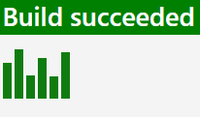
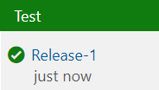

Boom!
Functional tests pass
Requires PO approval
Devin
Devin
4:15pm
4:45pm
Notes:
4:15pm: Devin re-runs the build. It passes!
Deploys to Test. Some exploratory testing. Functional tests pass. Ready to go to UAT.
4:45pm: Can’t deploy to UAT; requires PO approval gate.
Stacy has already left for the day.
Devin is crushed.

Slide 13

I’m on it!
Where’s your ticket? What’s the SEVERITY?!
Let’s do this!
Why’d it break?!
Test
UAT
Prod
Devin
Stacy (PO)
Pete (Platform team)
Devin
8:45am
9:15am
Wednesday (Day 2)
Notes:
8:45am: Daily stand-up. Devin says ready to deploy to UAT. Stacy says, “I’m on it.”
9:15am: Deploy to UAT. Post-deploy functional tests fail. It worked in test!
Need to contact the Platform Hosting team.
Pete from P.H. team – with the on-call phone – always looks a bit on edge.
“Where’s the JIRA ticket? What’s the severity?!”
Devin: It’s not prod. But it is important.”

Slide 14

Database issue. NOT IT!
Where’s your ticket?
Test
UAT
Prod
Pete (Platform team)
Abby (DBA Lead)
Devin
11:30am
Notes:
11:30am: Platform is fine. But a DB Schema change hasn’t been applied to UAT yet. Need to contact DBA team.
DBA Lead, like “Where’s your ServiceNow ticket?”

Slide 15
Prod issue. Sorry.
Brent (DBA SME)
Abby (DBA Lead)
Devin
Devin
11:45am
4:00pm
Notes:
11:45am: Ticket submitted, but DB SME most familiar with change – Brent – just left for lunch.
4:00pm: Follow-up with Abby. Says Brent was pulled into SEV1 incident all afternoon. Promises he’ll look at it tomorrow morning.

Slide 16
Will it be today?
It’s gotta be!
Devin
Stacy (PO)
8:45am
Thursday (Day 3)
Notes:
8:45am: Daily stand-up. Stacy asks if today will be the day. Devin say, “It has to be!”

Slide 17
Wow! This AGILe stuff really works!
We had this idea. Rolling it out this afternoon.
Stacy (PO)
Dan (Business leader)
9:05am
Notes:
9:05am: Stacy has a chat with Dan, business leader.

Slide 18

Excelsior!
Test
UAT
Prod
Devin
Kurt (HR leader)
9:15am
9:30am
9:45am
Notes:
9:15am: DB Schema has been applied. UAT environment test working again. Devin’s like “Excelsior!”
9:30am: Submits change ticket. Coordinates DB changes with Brent. Ready to go.
9:45am: Goes to HR leader, who has no context for this change at all!
What’s more, Kurt is in meetings all day, but promises to look at it as soon as he can.

Slide 19


Kurt (HR leader)
12:00pm
Notes:
12:00pm: Kurt’s back from meetings. Take a look at change ticket.
Through several years experience + strong leadership prowess, determines whether change is safe to make.
Approved

Slide 20

Worth it!
Test
UAT
Prod
Devin
12:45pm
Notes:
12:45pm. Deploy to Prod succeeds. All tests pass.
Devin: “Worth it!”
Devin takes the rest of the day off. Because that’s what delivery teams do. Deploy and then leave.

Slide 21
You’re AGILe. Let’s get this done by noon.
Devin
Stacy (PO)
Dan (Business leader)
8:45am
Friday (Day 4)
Notes:
Here’s the kicker…
8:45am: Daily stand-up. Dan says the new feature is having negative impact on customers; needs rolled out of production right away.
Dan says, “You’re agile. Let’s get this done by noon today.”

Slide 22

Most Companies chase the symptoms…
…by using conventional thinking:
“We need more people.” (e.g. full-stack team)
“We need better tools.”
“We need more discipline and attention to detail.”
“We’ll just wait and see what Gene Kim’s next book says…”
Notes:
Counter-arguments:
“We need more people” ← Example showed hand-offs and delays even within the tea
“We need better tools” ← We have legacy software, architectures, etc. Sometimes we don’t have control over replacing those.
“We need more discipline & attention to detail.” ← Like saying we just need to watch our queues closer and be more responsive. That’s not sustainable and most people don’t want to do that job. As leaders, we don’t want to pay top-talent to sit and watch queues all day.
How can we instead apply lean concepts to help us discover what’s truly slowing down the flow of work?

Slide 23
How can we instead apply lean concepts to help us discover what’s truly slowing down the flow of work?

Slide 24
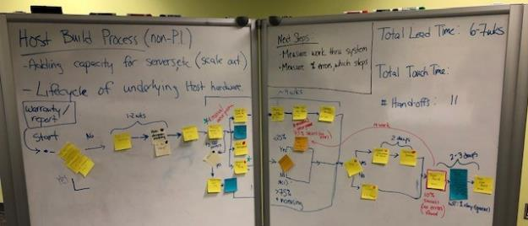
Introduction to Value Stream Maps
Notes:
VSM is a tool in the toolbox.

Slide 25

Value Stream Map (VSM)
A lean technique used to visualize, analyze, and improve the flow of work through a system.
Helps to identify constraints and bottlenecks.
Captures current state conditions of lead time and cycle time.
Notes:
Fact-based way to show how value how value flows through an organization.
Helps to identify constraints and bottlenecks in the current state and remove/reduce their impacts on the value flow of a system.

Slide 26
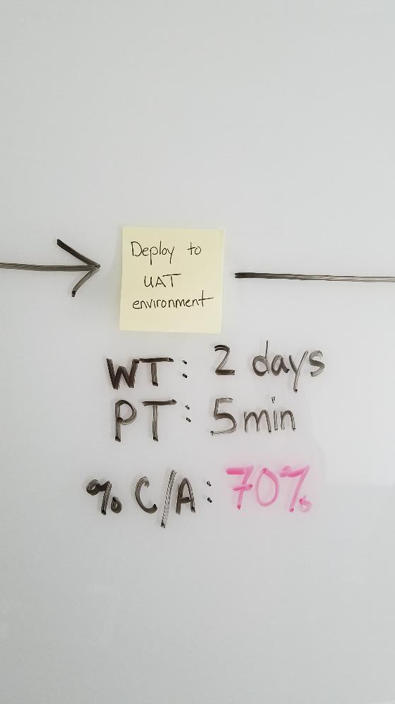
Capturing VSM Metrics
Lead Time (LT): Total time from when work enters a system to when value is delivered
Process Time (PT): Total time spent actually working on the activity
(a.k.a Value-Add Time)
% Complete/Accurate (C/A): proportion of work that is typically done right the first time without any re-work

Slide 27
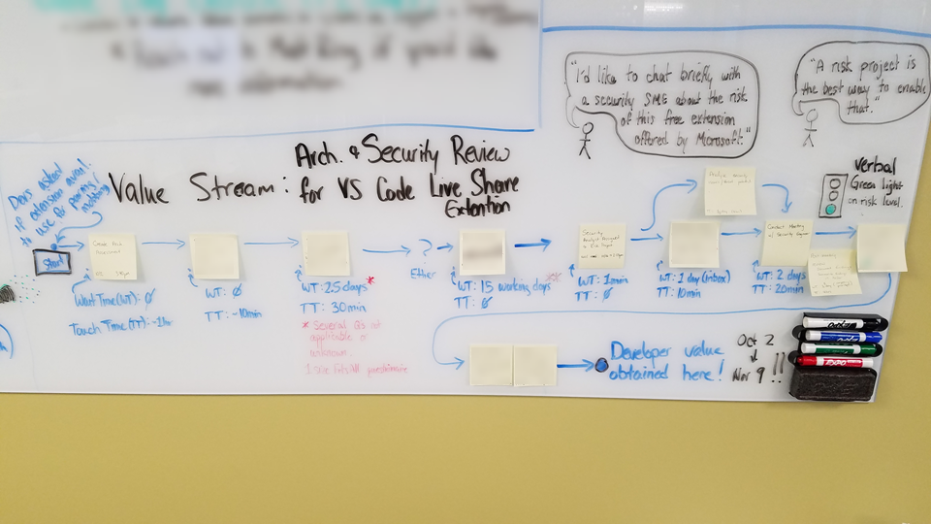
An early example
Notes:
Total Lead Time: 28 working days
Total Value-Add Time: ~14 hours
Total Hand-offs: 8 (across three people)
% time spent on value-add work: 6%

Slide 28
Initial Findings
Total Lead Time: 28 working days (Oct. 2 – Nov. 9)
Total Process Time: ~14 hours
Total Hand-offs: 8 (across three people)
% time spent on value-add work:
6%

Slide 29
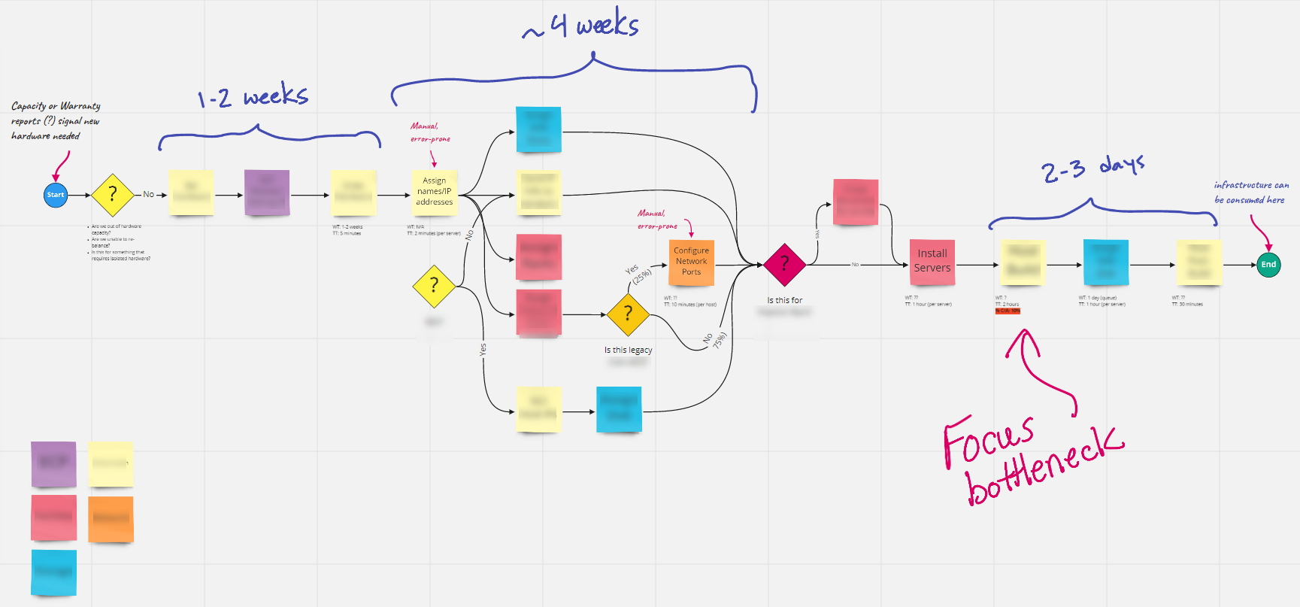
An infrastructure Example
Notes:
Other VSM examples we’ve used:
Periodic system maintenance (monthly OS patches)
Certificate management
CI/CD pipelines
Next goal: What does it take to create a “Hello World” app and deploy it to our on-premise environment.
Example using Miro (formerly RealTimeBoard). Can also use other more sophisticated modeling or business process management (BPM) tools.
Choose what’s “good enough” and start there.

Slide 30
Resist the temptation to play improvement whack-a-mole.
Notes:
The “How”

Slide 31

Instead, focus on the biggest constraint.
Notes:
Why not just focus on any improvement we see? Let’s avoid improvement whack-a-mole.
We want to ensure we’re focusing always on the biggest constraint.
Why is that?... To answer that, we need to talk briefly about the Theory of Constraints.

Slide 32
Theory of Constraints
Starved Resource
Completed
In Progress
Waiting

Slide 33
Effects of Rework
Starved Resource
Completed
Defect/Rework
In Progress
Waiting

Slide 34
The local optimization illusion
Improvements made after the bottleneck will remain starved of work.
Improvement made before the bottleneck results in increased WIP.
Notes:
"Any improvements made anywhere besides the bottleneck are an illusion. Any improvements made after the bottleneck is useless because it will always remain starved, waiting for work from the bottleneck. Any improvement made before the bottle neck merely results in increased WIP at the bottleneck.“
Teams on top will just have more free time, playing ping-pong or going rock climbing.
Teams on bottom will have more pressures, frustrations built-up. Likely to sacrifice quality for throughput.

Slide 35
Conducting Value Stream Mapping Workshops
Notes:
The “How”

Slide 36
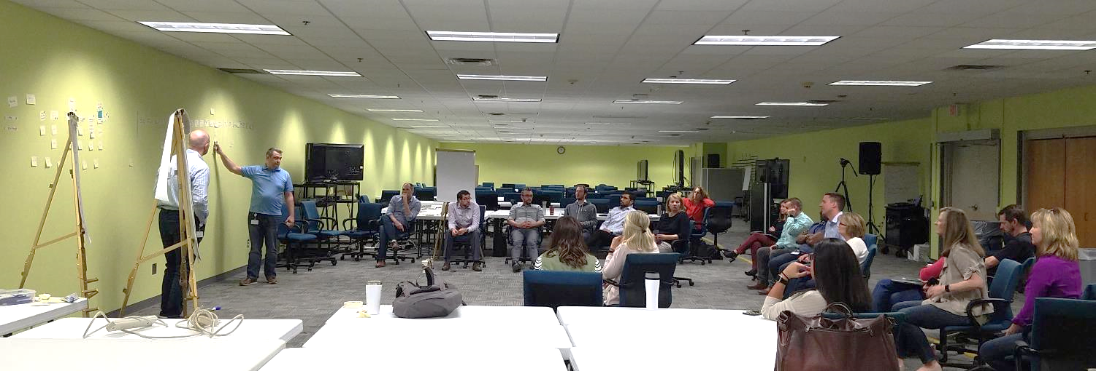
Don’t leave anyone out
Include anyone & everyone who contributes to the overall value stream.
Everyone is needed to document reality.
Team members and leaders play key roles.
Notes:
Include anyone & everyone who contributes to the overall value stream.
If this is an issue getting people together for this amount of time, food is always a great motivator. Buy lunch. Find a leader with a budget & get them to buy lunch.
Everyone is needed to document reality.
From Courtney Kissler: “Sometimes leaders think they know how work is getting done, but more often than not, they don't have as firm an idea as they think they do. Having the team members create the map is important but leaders also need to play a key role. Leaders need to create the space for the teams to create the map and then to problem solve an experiment going forward to reduce waste identified in the value stream.

Slide 37
Example VSM Workshop Format*
Create shared understanding of Lean and how it applies to software delivery.
Identify the problem(s) you’re trying to solve (desired outcomes).
Document current state step-by-step process to ship a typical feature.
Team estimates how long each step takes, including wait time (WT), process time (PT) and %C/A.
Document future state (remove steps, reduce total wait time)
Notes:
In the workshop the first step is to give the group a shared understanding of lean and how it applies to software delivery.

Slide 38
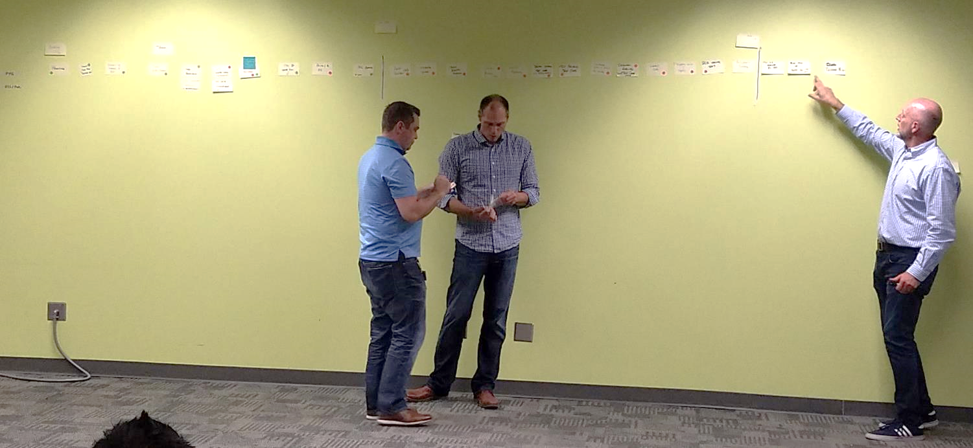
Facilitator Pairing
Notes:
Also good idea to pair up on facilitating a VSM.
One person can lead discussion
One person can document flow.
Variation:
* Give each team / rep sticky notes, have them write down their activity and post it. Makes them more engaged; not just sitting around.

Slide 39

Enable Psychological Safety
Notes:
Participants may feel defensive, especially as we start to dig into the process. It’s important to promote an environment where people feel comfortable talking about problems with the process without pointing blame.

Slide 40
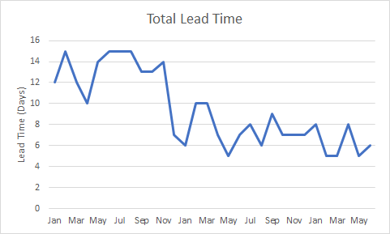
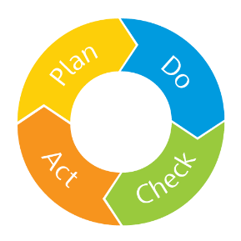
Measure impacts along the way
Notes:
Control chart? Won’t go into depth on topic, reference of other info for those interested?

Slide 41
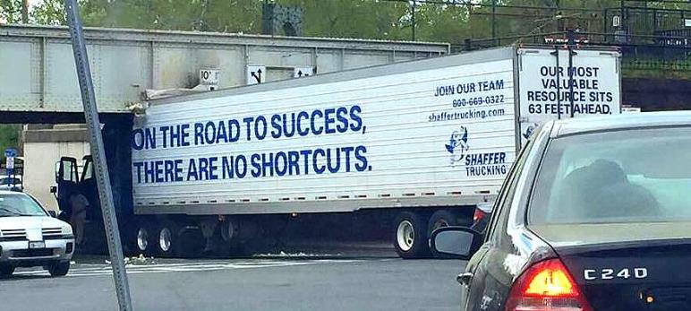
Don’t underestimate time to improvement
Notes:
In our recent experience, we’ve tried to do VSM workshops in windows of 1-3 hours. Typically for those, we had just enough time to capture most or all of the current state and highlight where the biggest constraint would be. But in that time, we fail to capture future state and give team members an opportunity to problem solve, or create actionable steps to make improvements.
To see meaningful improvement, you’ll need to invest the appropriate time to evaluate processes.

Slide 42
Where to go from here…
Notes:
The “How”

Slide 43

The Comment Commit – John Allspaw
"Measure cycle time of a comment change pushed to production."
Low risk, easy change to gain VSM familiarity.
Energizes team to see what’s possible.
Notes:
Call to action for teams
John Allspaw, former CTO at Etsy.com
Suggested measuring a comment change on a file into product.
Low Risk, Easy work.
Measure cycle time and process steps.
Gain familiarity with VSM and terminology.

Slide 44
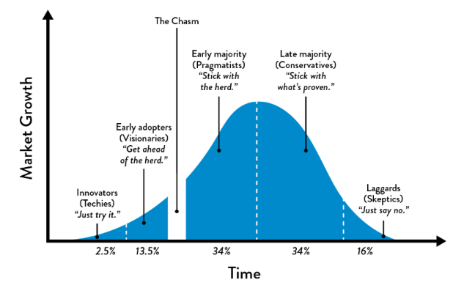
Invest in early adopters
Notes:
If you are a leader of teams, leader of leaders or a change agent in your organization, understand who are your innovators and early adopter teams? Start with those that are interested and passionate about improving the systems they work with.

Slide 45
“
You can do anything. But you can’t do everything.
–David Allen, Getting Things Done
”
Notes:
Requesting production like environments
Change approval processes
Security review processes.

Slide 46
Focus where there’s significant delay (long lead time).

Slide 47
Focus where there’s significant re-work (low %C/A).

Slide 48
Avoid the temptation of improvement whack-a-mole.

Slide 49
Additional Resources
Operations: The Last Mile (Damon Edwards, DOES 2018)
How Finding & Fixing Faults is the Path to Perfection (Steven Spear, DOES 2018)
Coursera: DevOps Culture & Mindset (Courtney Kissler)
The DevOps Handbook (Gene Kim, et. al.)
The Goal (Dr. Eliyahu M. Goldratt)

Slide 50

Thank you!

